Slide 1
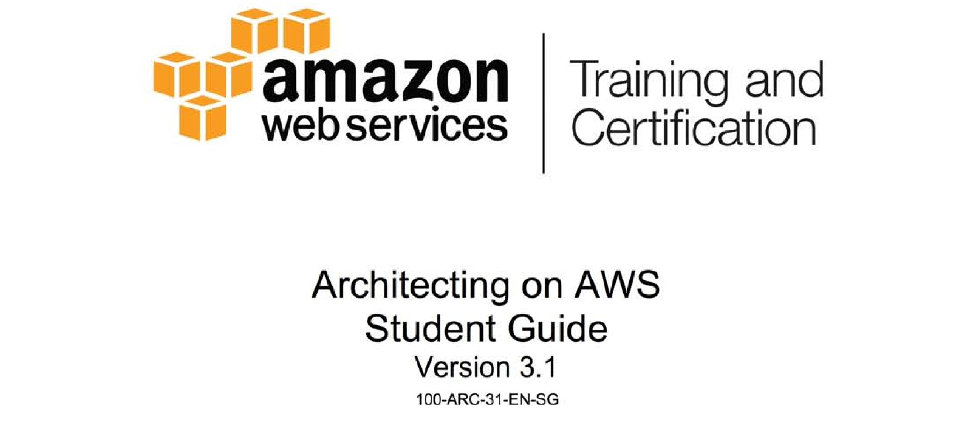
Notes:
1

Slide 2

Module 3: Security and Compliance
Notes:
2

Slide 3
Before we start….
Identify the correct statements:
Security and patching of the operating system and the application is the responsibility of the customer. | Penetration testing is a violation of the AWS Terms of Service. | Data on block storage devices (ephemeral storage and EBS) is encrypted by default.
Port scanning is performed by AWS to check for vulnerabilities in your application. | AWS is PCI DSS Level 1 certified, but customers are responsible for managing PCI compliance and certification for their own applications. | Each AWS Region has at least one Disaster Recovery Availability Zone.

Slide 4
Topics
The shared responsibility security model
AWS role in security
Your role in security
Securing networks with Security Groups
Notes:
4

Slide 5
Topics
The shared responsibility security model
AWS role in security
Your role in security
Securing networks with Security Groups
Notes:
5

Slide 6
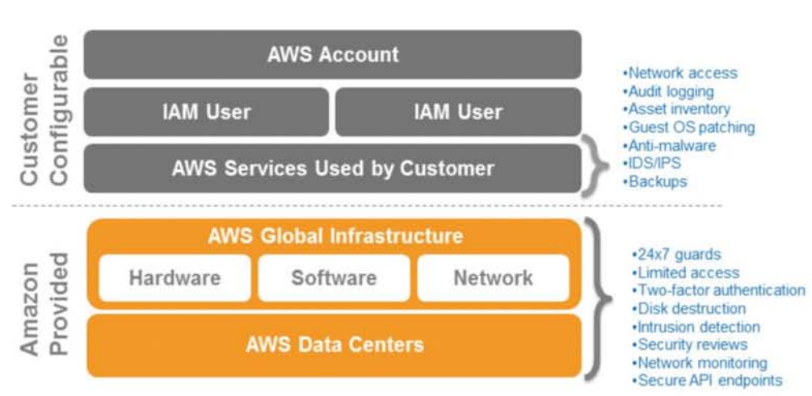
The shared responsibility security model

Slide 7
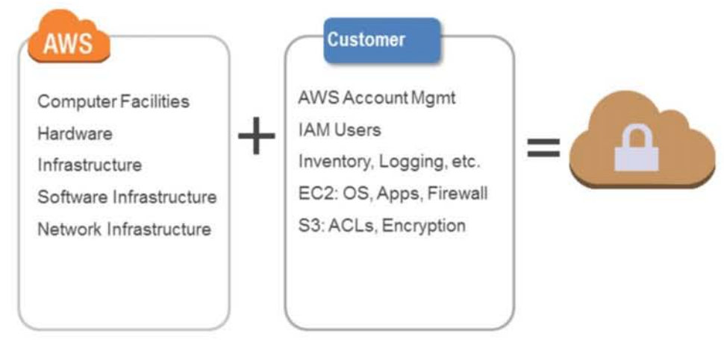
The shared responsibility security model
Notes:
7

Slide 8
Topics
The shared responsibility security model
AWS role in security
Your role in security
Securing networks with Security Groups
Notes:
8

Slide 9
AWS role in Shared Responsibility Security Model
AWS
Facilities
Physical Security
Physical infrastructure
Network infrastructure
Virtualization infrastructure
Third-Party Attestations, Reports, and Certifications for the above
Customer
Operating system
Application
Security groups
OS Firewalls
Network configuration
Account Management
Certifying your applications
Notes:
9

Slide 10
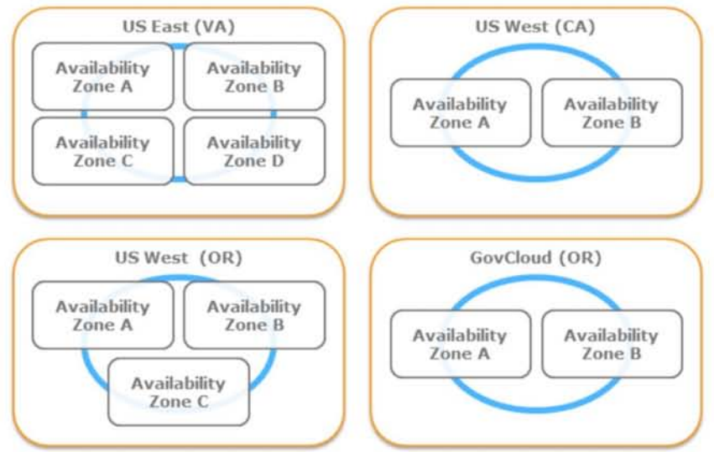
AWS US Regions

Slide 11
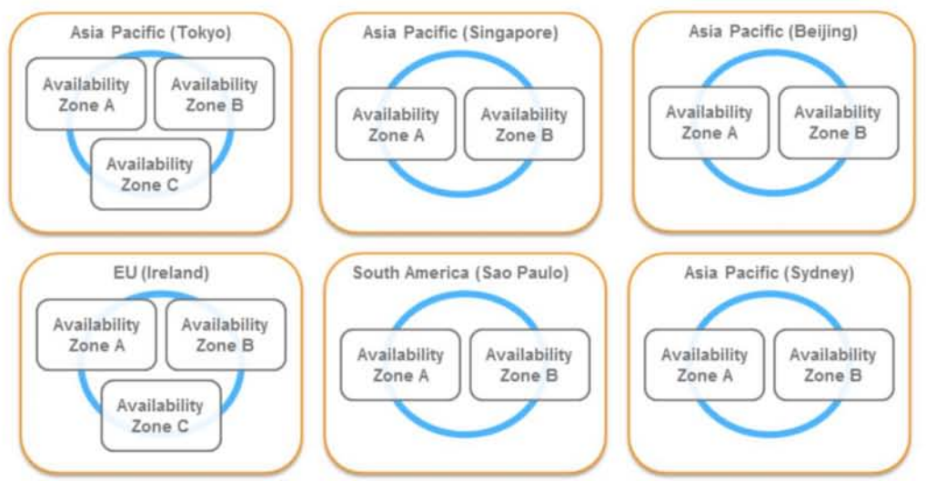
AWS Global Regions

Slide 12
Physical Security
Controlled, need-based access
All access is logged and reviewed
Multi-factor authentication
Separation of Duties
Employees with physical access do not have logical access
24 x 7 security guards

Slide 13
Network Security
Distributed Denial of Service (DDoS)
Standard mitigation techniques in effect
Man in the Middle (MITM)
All API endpoints protected by SSL
IP Spoofing
Prohibited at host OS level
Unauthorized Port Scanning
Violation of TOS
Detected, stopped, and blocked
Packet Sniffing
Promiscuous mode ineffective
Protection at hypervisor level

Slide 14
Storage Device Decommissioning
Uses techniques from:
DoD 5220.22-M (“National Industrial Security Program Operating Manual”)
NIST 800-88 (“Guidelines for Media Sanitization”)
Ultimately, all devices are:
Degaussed
Physically destroyed

Slide 15
Virtual Memory and Local Disk Space
Proprietary disk management prevents one instance from reading disk contents of another
Disk is wiped upon creation
Disks can be encrypted by customer

Slide 16
AWS Third-Party Attestations, Report, and Certifications
AWS Environment
Service Organization Controls(SOC) Reports
SOC 1 Type II (SSAE 16/ISAE 3402/formerly SAS70)
SOC 2 Type II
SOC 3
Payment Cart Industry Data Security Standard (PCI DSS) Level 1 Certification
ISO 27001 Certification
FedRAMPSM
DIACAP and FISMA
ITAR
FIPS 140-2

Slide 17
AWS Third-Party Attestations, Report, and Certifications(continue)
Customers have deployed various compliant applications:
Sarbanes-Oxley (SOX)
HIPAA (healthcare)
FedRAMPSM (US Public Sector)
FISMA (US Public Sector)
ITAR (US Public Sector)
DIACAP MAC III Sensitive IATO

Slide 18
Topics
The shared responsibility security model
AWS role in security
Your role in security
Securing networks with Security Groups

Slide 19
Your role in Shared Responsibility Security Model
AWS
Facilities
Physical Security
Physical infrastructure
Network infrastructure
Virtualization infrastructure
Third-Party Attestations, Reports, and Certifications for the above
Customer
Operating system
Application
Security groups
OS Firewalls
Network configuration
Account Management
Certifying your applications

Slide 20
Account Management
Master (root) account has root/admin-level access
Multiple accounts may be created to isolate resources
Account may be isolated by:
Environment (dev, test, prod)
Major System
Line of business/function
Customer
Risk level

Slide 21
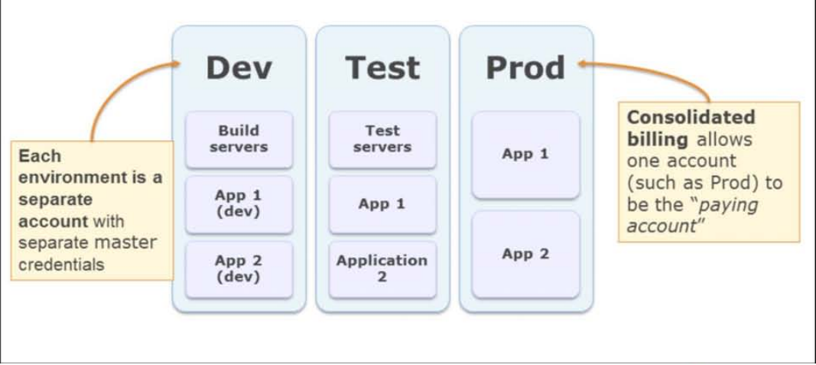
AWS account management by enviroment

Slide 22
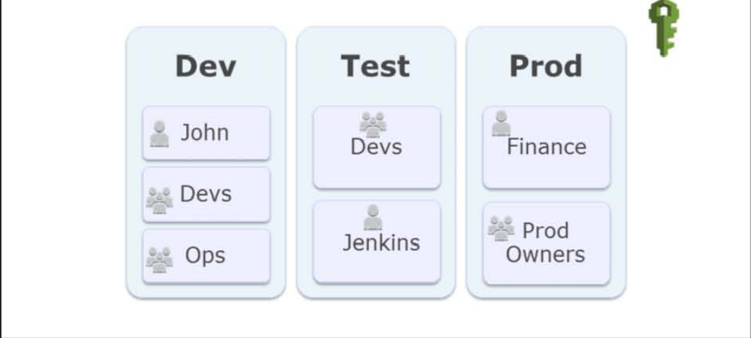
Identity and Access Management

Slide 23
Operating system security
Guest (instance) operating system
Customer controlled (customer owns root/admin)
AWS admins cannot log in ← Why not?
EC2 Key Pairs
You (and only you) have the private half of the key
You (and only you) can:
SSH to the instance (Linux)
Decrypt the Administrator password (Windows)

Slide 24
Operating system security
You still need to patch
Most traditional tools will work
Emerging options
Chef(www.opscode.com/chef)
Puppet(www.pupetlabs.com)
Fabric/Cuisine(www.fabfile.org)
Capistrano(https://github.com/capistrano/capistrano/wiki)
Amazon OpsWorks(https://aws.amazon.com/opsworks)

Slide 25
Your Data
Protect privacy and enforce your policies with data encryption
Encrypt data in transit
(SSL/TLS)
Encrypt data at rest
Consider encrypted file systems for sensitive data
Encrypt objects before storing them
Encrypt records before writing in database
EBS and Ephemeral volumes can be encrypted
Variety of options
EncFS, Loop-AES, dm-Crypt, TrueCrypt, etc….

Slide 26
Encryption: File Systems
Managing encryption keys
Study key management capabilities of encryption product(s) you choose
Establish a procedure that minimizes possibility of losing keys
AWS CloudHSM
Securely generate, store and manage cryptographic keys used for data encryption
Dedicated SafeNet Luna SA

Slide 27
Use Multiple Security Layers
Security Groups (EC2, VPC, RDS, ElastiCache, Redshift)
Bastion Host
Host-based Firewalls*
IDS*

Slide 28
Topics
The shared responsibility security model
AWS role in security
Your role in security
Securing networks with Security Groups

Slide 29
Network Security: Security Groups
Control inbound traffic
VPC groups can also control outbound
Apply many Security Group to one instance
Default group: no access
Several services use Security Groups
EC2
VPC(more advanced features)
RDS
ElastiCache
Redshift

Slide 30
Network Security: Security Groups(continue)
When defining inbound rules, specify source by:
CIDR address
0.0.0.0/0 for Internet, 10.0.0.0/16 for EC2 private, and so on
Security Group Name
Restrict access to other EC2 instances in the specified security group

Slide 31
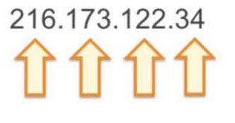
CIDR Notation: An Overview
CIDR notation is useful for expressing a range of IP address
Consider this IP(v4) address:
Each number can have a decimal value between 0 to 255
Each number is a single byte(8 bits)

Slide 32

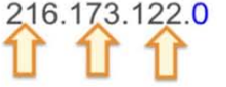
CIDR Notation: An Overview
What if you wanted to express a firewall rule that allowed traffic from any address in the last octet?
Specify the first valid number in the range. If we want to allow all values in the last octet, the first allowable value is 0
In this case, we want to freeze the first 3 octets: 3 octets == 3 bytes == 24 bits. Therefore → 216.173.122.0/24

Slide 33
CIDR Notation: A few more examples
Match an exact address
216.173.122.34 216.173.122.34/32
Match any address
*.*.*.* 0.0.0.0/0

Slide 34
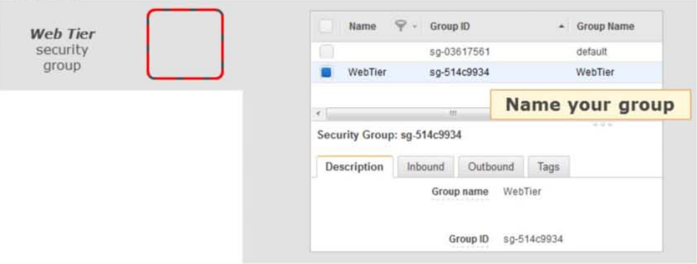
Security Groups Example: Web Server Instance(1 of 3)
Design a security group for Apache web servers in your application’s web tier

Slide 35
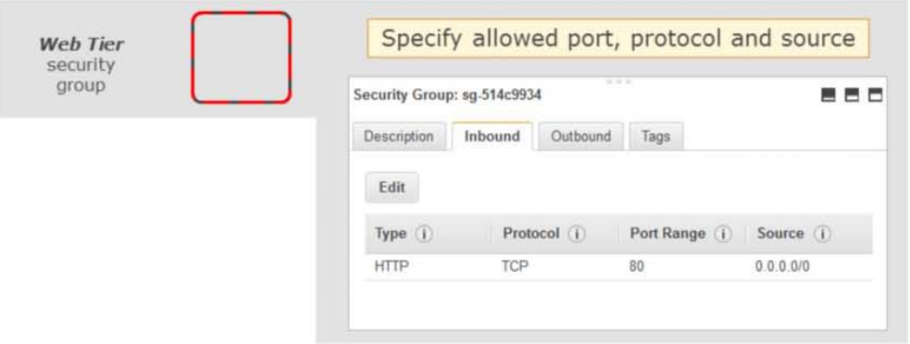
Security Groups Example: Web Server Instance (2 of 3)

Slide 36
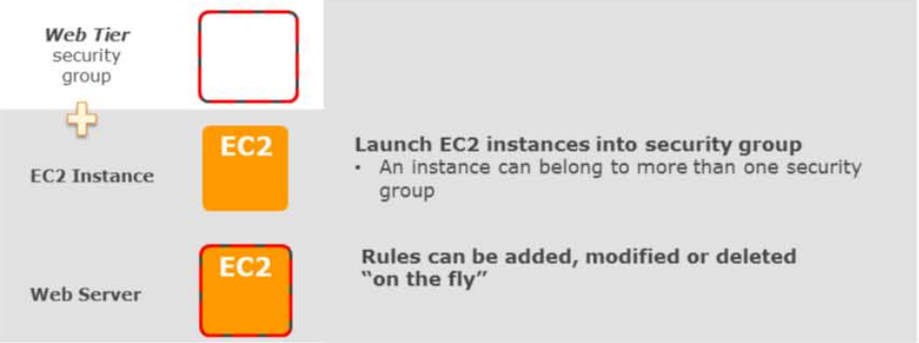
Security Groups Example: Web Server Instance (3 of 3)

Slide 37
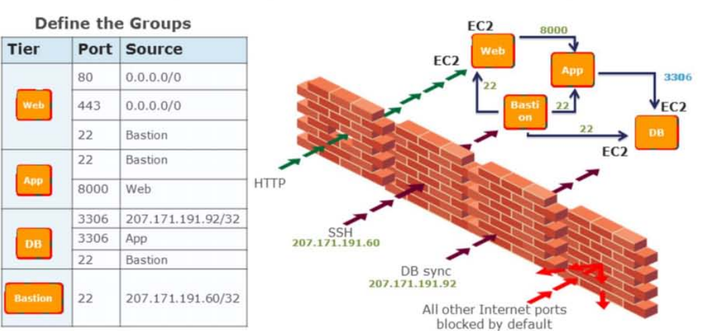
Security Groups Example: Multi-tier Security Group Activity

Slide 38
Most security best practices still apply in the Cloud
Secure coding standards
Perform penetration testing
http://aws.amazon.com/security/penetration-testing
Antivirus where appropriate
Intrusion Detection
Host-based Intrusion Detection (such as OSSEC)
Log events
Role-based access control
AWS Identity & Access Management
LDAP and/or Active Directory for Operating System & Applications

Slide 39
Module review
What are the five main layers of security for cloud architecture?
What security model is used with AWS services
What areas of security is AWS responsible for?
What areas of security are you, the customer, responsible for?

Slide 40
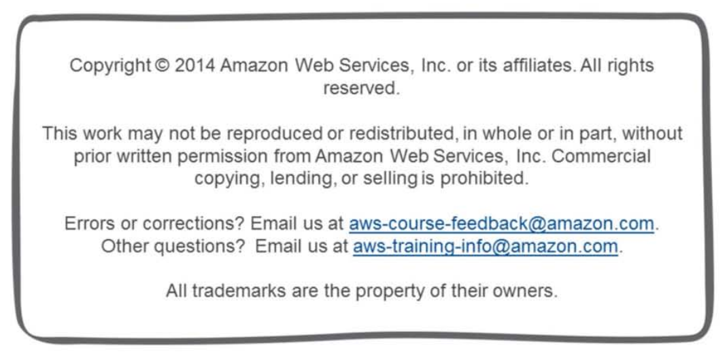
Notes:
40

Slide 41
Appendix

Slide 42
Activity---Identify Security Mechanisms
Consider the architecture for a scalable web application. How do you secure it? Address the following aspects of security:
Physical
Network
Data(in transit and at rest)
Operating system
Security credential management
Logging

Slide 43
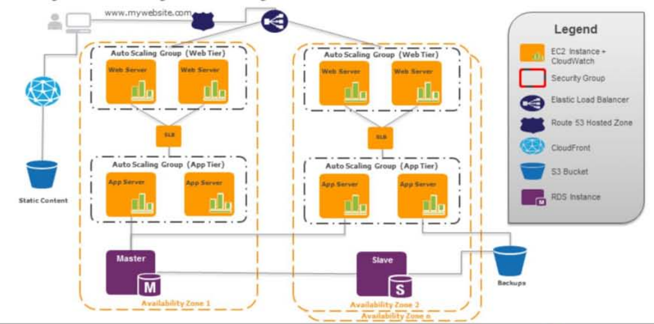
Activity --- Identify Security Mechanisms

Slide 44
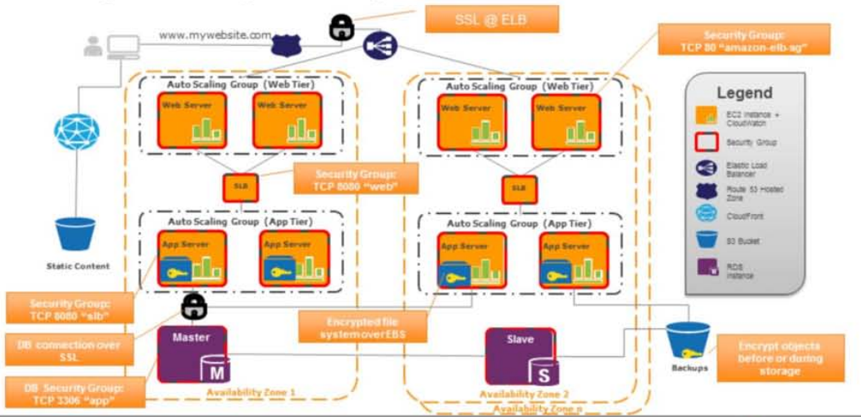
Activity --- Identify Security Mechanisms

